Slide 1

📡Customer Churn Analysis – Risk & Revenue Insights
Prepared/Presented By :- Vishal Sanjay Raut
Tool Used: Power BI

Slide 2
AGENDA 📋
• Business Problem
• Dataset Overview
• Key Performance Indicators(KPI’s)
• Churn Drivers Analysis
• Churn Risk Analysis
• Revenue Impact of Churn
• Key Insights & Recommendations
• Final Dashboard
• Conclusion

Slide 3
BUSINESS PROBLEM ⚠️
• Telecom companies face high customer churn.
• Acquiring new customers is more expensive than retaining existing ones.
• The business lacks clarity on:
• Why customers are leaving?
• Which customers are at high risk?
• How much revenue is being lost due to churn?
Objective: Analyze churn drivers, identify high-risk customers, and assess revenue impact.

Slide 4
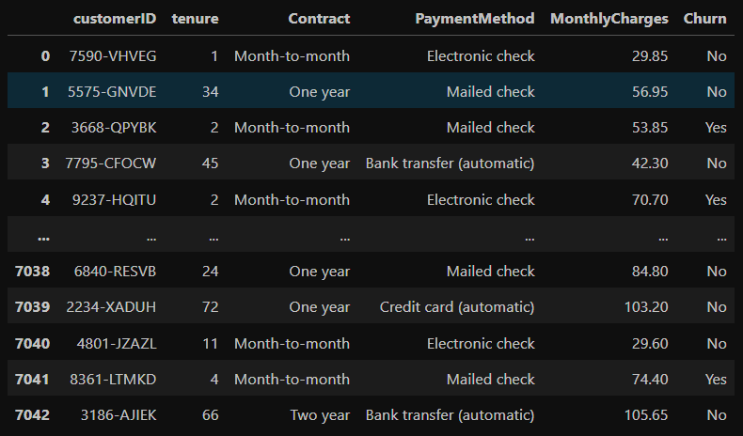
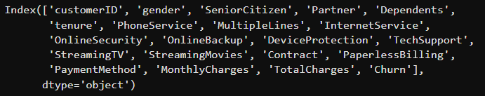

DATASET OVERVIEW
Dataset represents telecom customers.
Total Customers: 7,043
Key data fields include:
• CustomerID
• Customer tenure
• Contract type
• Payment method
• Monthly charges
• Churn status (Yes / No)
Dataset Columns
DataSet Shape

Slide 5
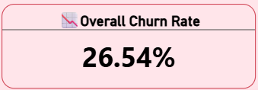
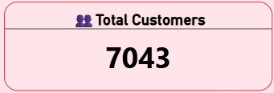
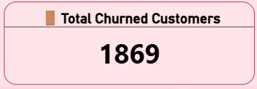
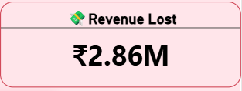
Key Performance Indicators(KPI’s)
Overall Churn Rate: 26.54%
Total Customers: 7,043
Total Churned Customers: 1,869
Revenue Lost: ₹2.86M
Insight :
Nearly 1 in 4 customers have churned, causing significant revenue loss.

Slide 6
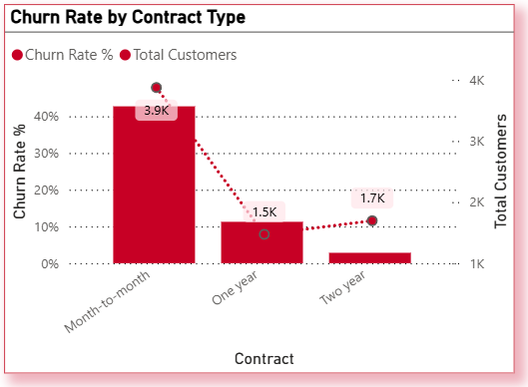
Churn Rate by Contract Type
Content:
• Month-to-month customers have the highest churn rate.
• Customers on one-year and two-year contracts churn significantly less.
Insight:
Customers without long-term commitment are more likely to leave.

Slide 7
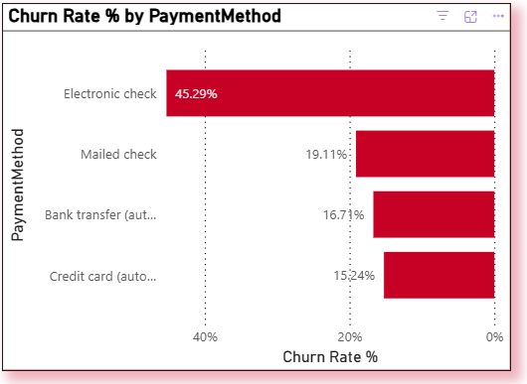
Churn Rate by Payment Method
Content:
• Electronic check users show the highest churn.
• Customers using automatic payment methods churn less.
Insight:
Payment convenience and trust influence customer retention.

Slide 8
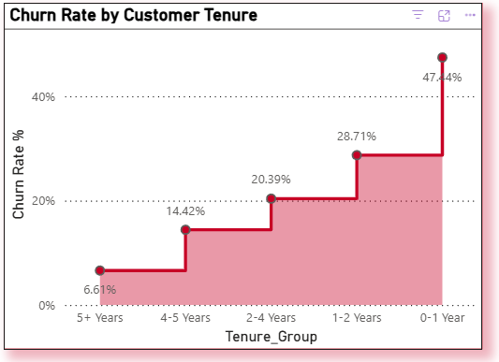
Churn Rate by Customer Tenure
Content:
  New customers (0–1 year) have the highest churn.
  Churn decreases as customer tenure increases.
Insight:
  Early customer experience plays a critical role in retention.

Slide 9
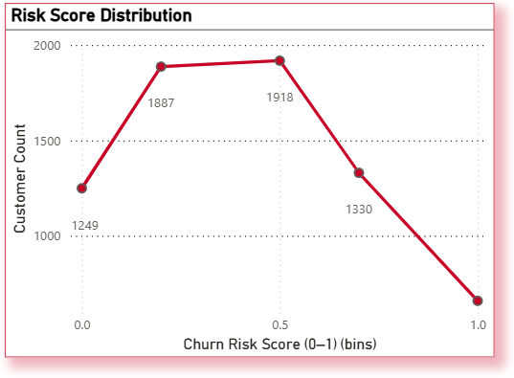
Churn Risk Analysis
Content:
  A rule-based churn risk score was created.
  Risk score is based on:
    Contract type
    Tenure
    Monthly charges
    Payment method
  Customers are grouped into:
    Low Risk
    Medium Risk
    High Risk
Insight:
  Customers classified as high risk show a significantly higher likelihood of churn compared to low-risk customers.

Slide 10
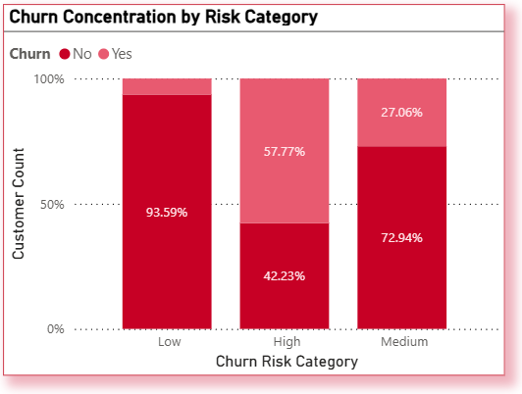
Churn Concentration by Risk Category
Content:
  High-risk customers have the highest churn rate.
  Low-risk customers churn very little.
Insight:
  Risk scoring effectively identifies churn-prone customers.

Slide 11
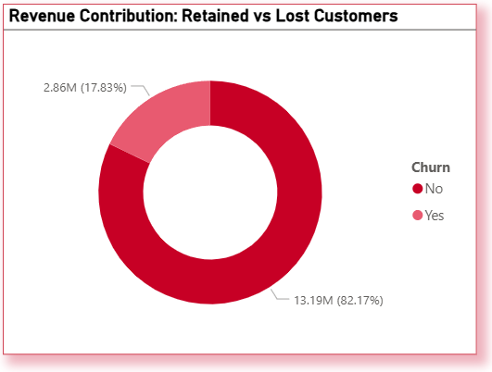
Revenue Impact of Churn
Content:
  Retained customers contribute significantly more revenue.
  Churned customers result in major revenue loss.
Insight:
  Reducing churn directly improves business profitability.

Slide 12
KEY INSIGHTS (SUMMARY)
Month-to-month customers have the highest churn.
Short-tenure users are the most unsafe.
High-risk customers drive major revenue loss.
Early retention can significantly improve revenue.

Slide 13
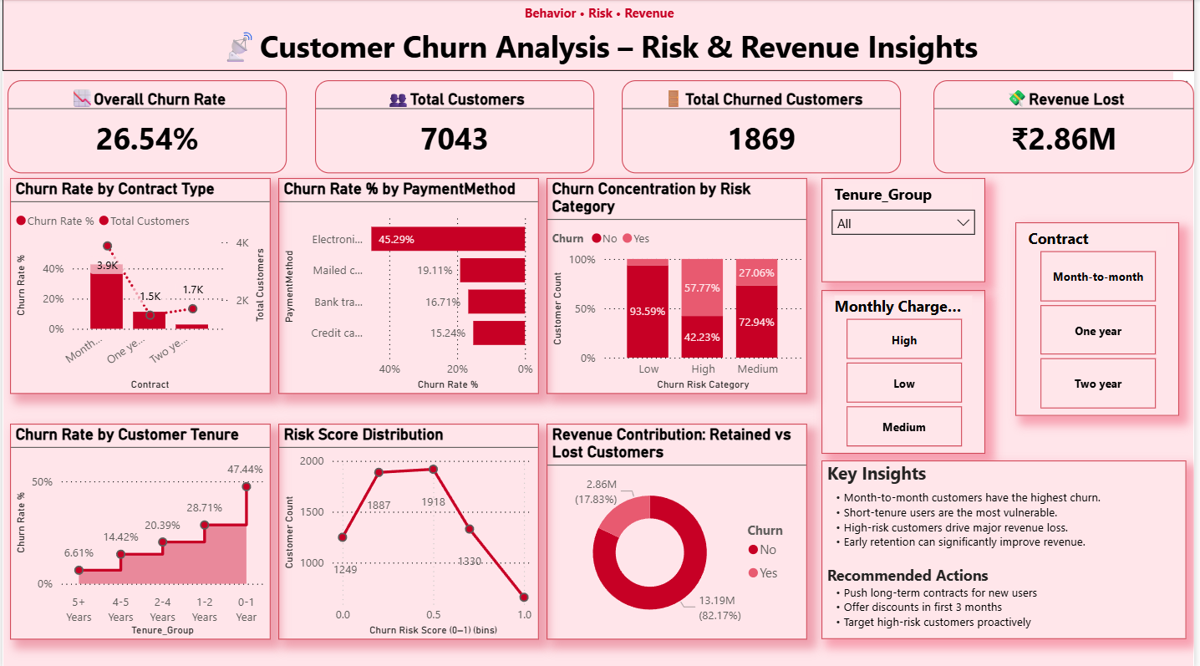
Final Dashboard

Slide 14
Recommended Actions
Encourage long-term contracts for new customers.
Improve onboarding experience during first 3 months.
Provide targeted offers to high-risk customers.
Use churn risk score for proactive retention strategies.

Slide 15
Conclusion
This project demonstrates that customer churn is driven primarily by contract type, tenure, and payment behavior. By identifying high-risk customers early and focusing on retention strategies, telecom companies can significantly reduce revenue loss.

Slide 16

THANK YOU

